Slide 1

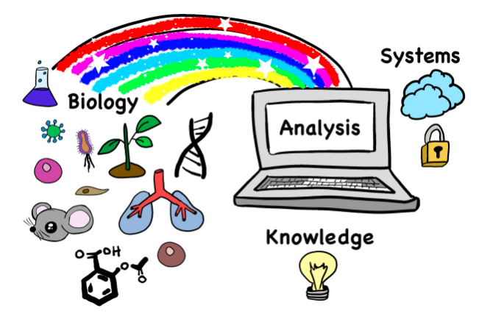
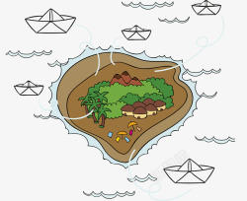
MicroWorldOmics motivation
Island Effect
Source
Need more interdisciplinary background
Basic programming language is required
Method
Technology

Slide 2

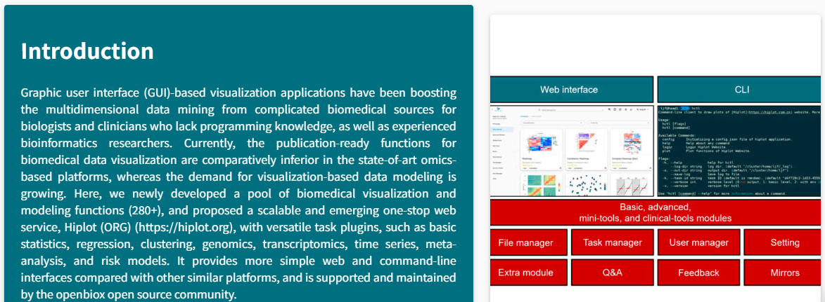
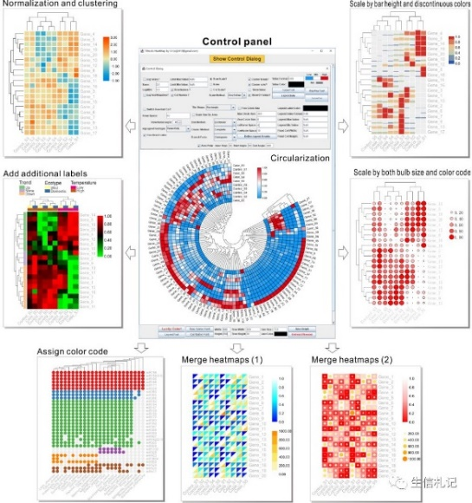
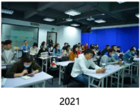
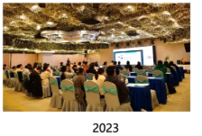
Research Status of Integrated Bioinformatics Analysis Platforms at Home and Abroad
Galaxy, an open-source web-based bioinformatics analysis platform developed by Pennsylvania State University in the United States, is widely used throughout North America and even around the world
Hiplot rewrote biomedical data analysis in 28 months and was acknowledged by over 2,100 papers from 15 national laboratories around the world
Tbtools, as a user-friendly graphical interface software tool, integrates multiple bioinformatics tools
Galaxy
Hiplot
TBtools

Slide 3
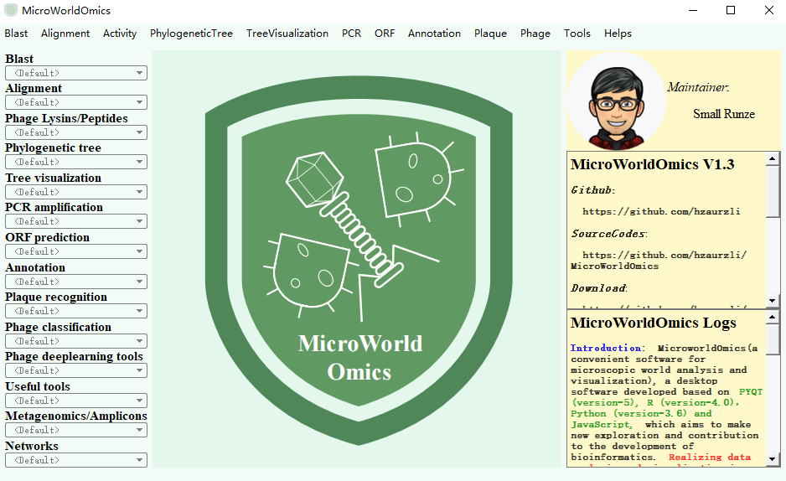
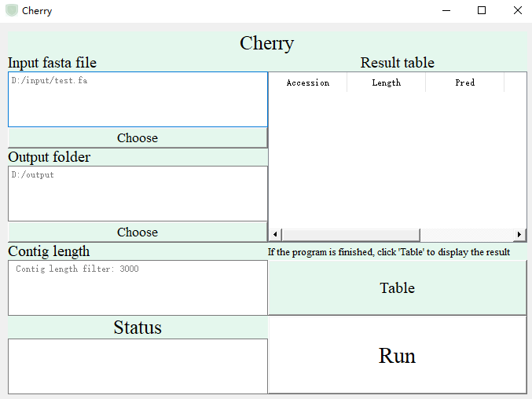
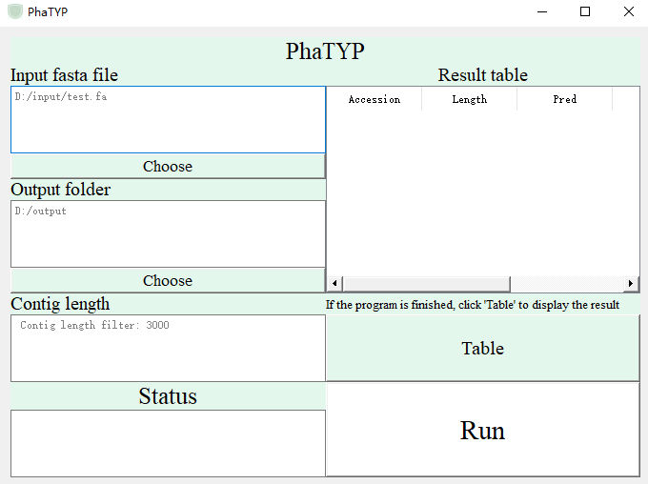
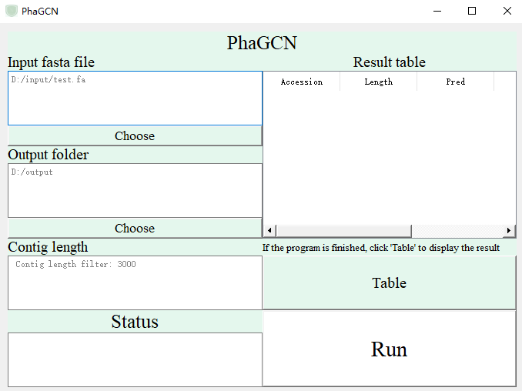
Drive bioinformatics software towards convenience
UI
Plugins
MicroWorldOmics

Slide 4
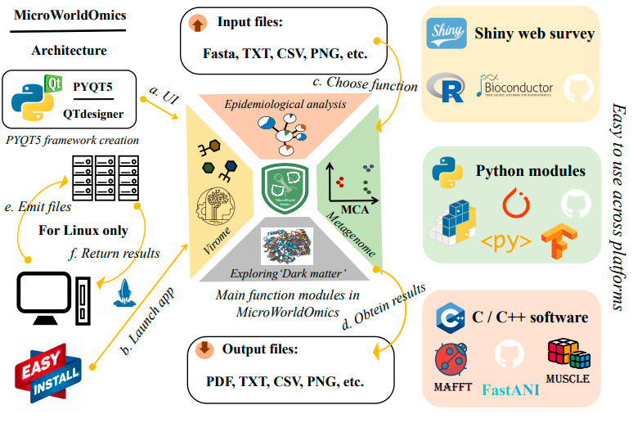
MicroWorldOmics design framework

Slide 5
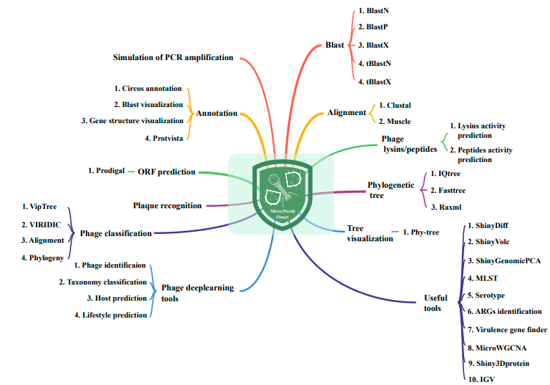
MicroWorldOmics functional function
More than 600+ packages were used
More than 300 APIs were called

Slide 6
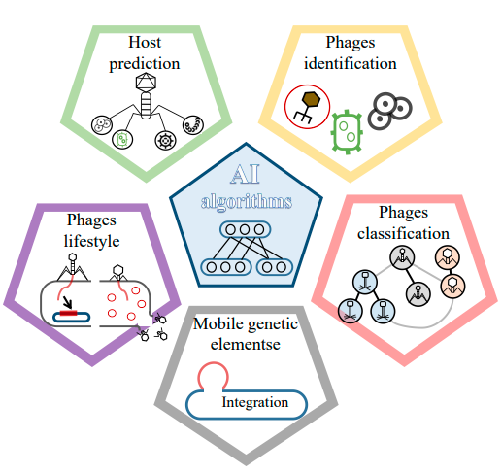
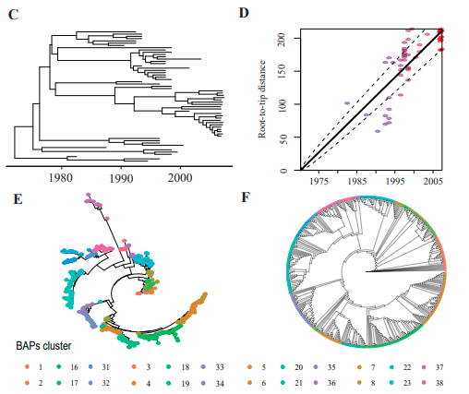
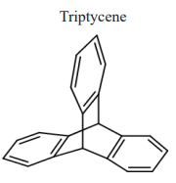
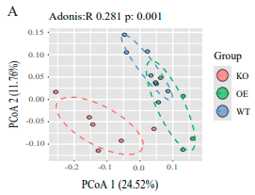
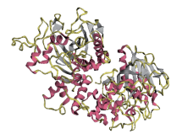
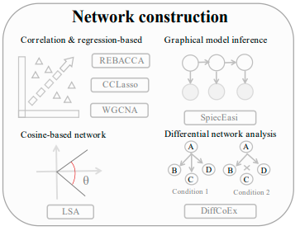
MicroWorldOmics main modules
Comprehensive analysis of phages
Genomic analysis of bacteria/fungi
Chemical structure drawing
Metagenomic/16s downstream analysis
Network construction
Protein alignment/visualization

Slide 7
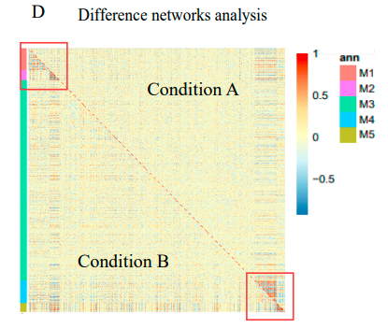
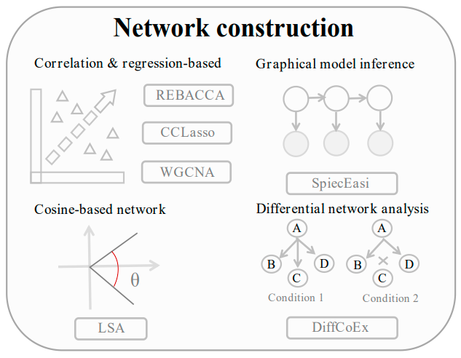
MicroWorldOmics differential network

Slide 8
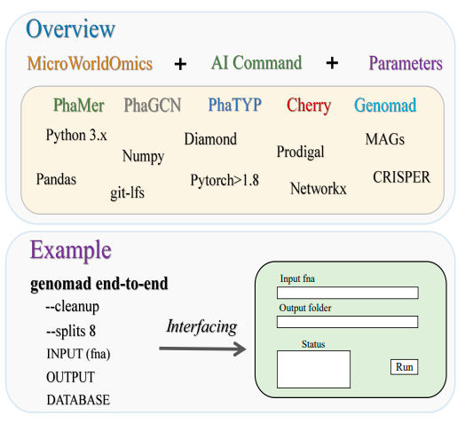
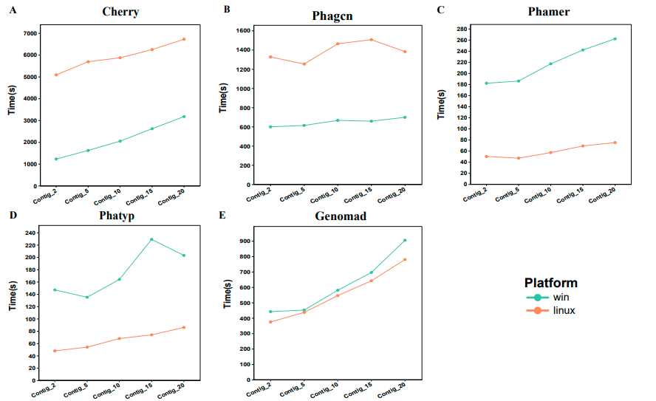
MicroWorldOmics transplant deep learning algorithms
Transplant the deep learning tools related to the discrimination of phage sequences, life style, species classification and host prediction
After the algorithm was rewritten, the running time of some methods in Windows was less than that on the workstation

Slide 9
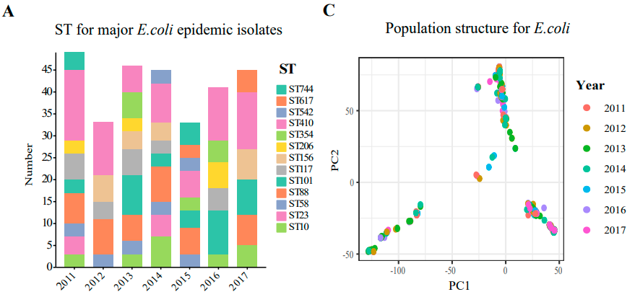
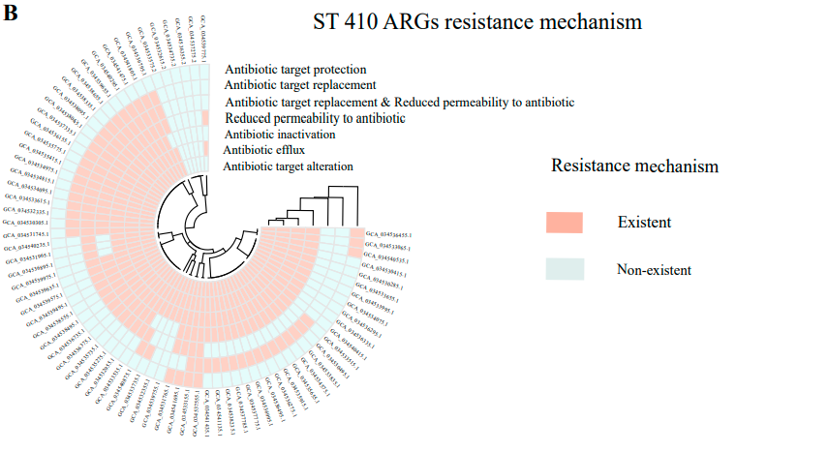
MicroWorldOmics Use Case - ExPEC as an example
Multilocus sequence typing (MLST), the demonstration output shows from different sources (sick pigs, healthy pigs and patients)
After obtaining the core genomes of all strains, PCA dimensionality reduction clustering was performed using the plugin ShinyGenomePCA
The plug-in can be used to describe the carriers of drug resistance genes, the distribution of serotypes and the distribution of sampling areas
Data from Xudong Li et al 2024 Nat Commun

Slide 10
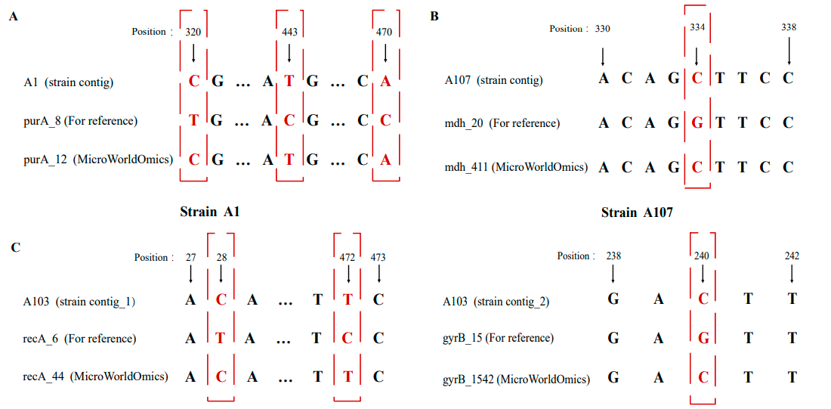
MicroWorldOmics Use Case - Optimizing MLST Identification
The identification of ST types of parenteral pathogenic Escherichia coli using the plug-in MLST is more accurate than that of SRST2
Data from Xudong Li et al 2024 Nat Commun

Slide 11
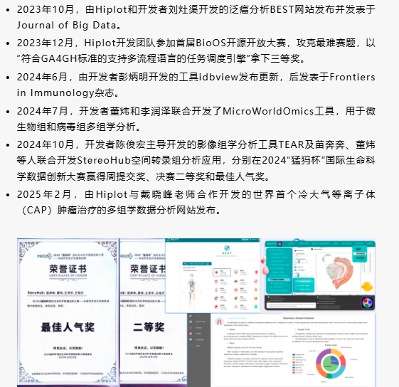
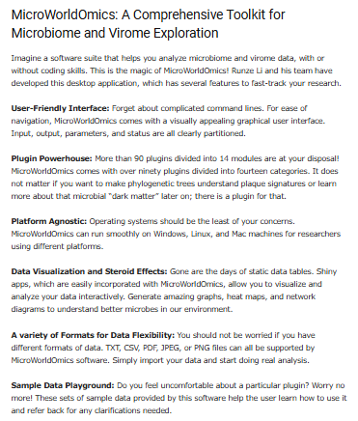
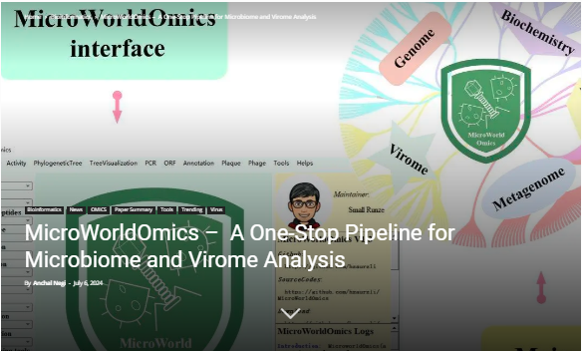
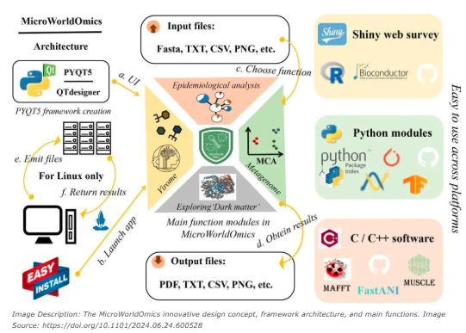
MicroWorldOmics is widely promoted
Received promotion from the development team of Hiplot, a large domestic biomedicine platform
The software developed by MicroWorldOmics has been promoted by the International Centre for Bioinformatics Research and Technology (CBIRT)

Slide 12
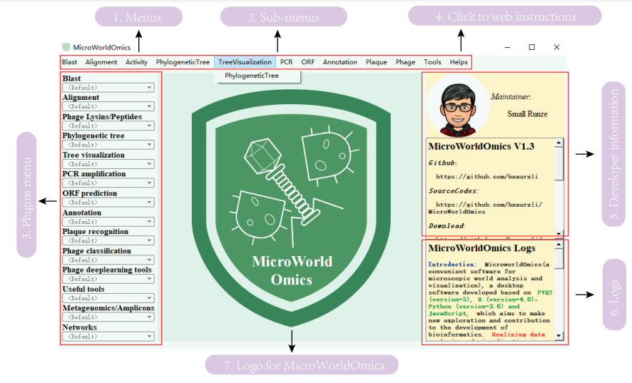
Summarize the work of MicroWorldOmics
A one-stop desktop application suite (with over 90 functional modules) for downstream bioinformatics analysis of the microbiome and virome has been established, making the related bioinformatics analysis more "user-friendly". Meanwhile, some plugins have been optimized to further enhance the analysis efficiency
Adopting the design concept of modular development makes the update and maintenance of the software more convenient. A software forum has been established to facilitate cloud developers to offer suggestions for the upgrade of MicroWorldOmics
Forum: https://hzaurzli.github.io/index.html
Github: https://github.com/hzaurzli/MicroWorldOmics

Slide 13
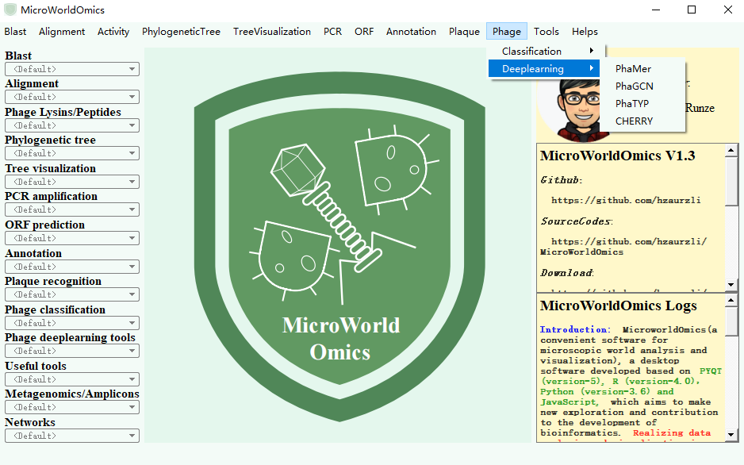
Comprehensive analysis of phages

Slide 14
Comprehensive analysis of the virome
PhaMer - Identify the phage sequence
PhaGCN - Species identification
PhaTYP – Life style identification
Cherry – Host prediction
Genomad – Mobile elements identification

Slide 15
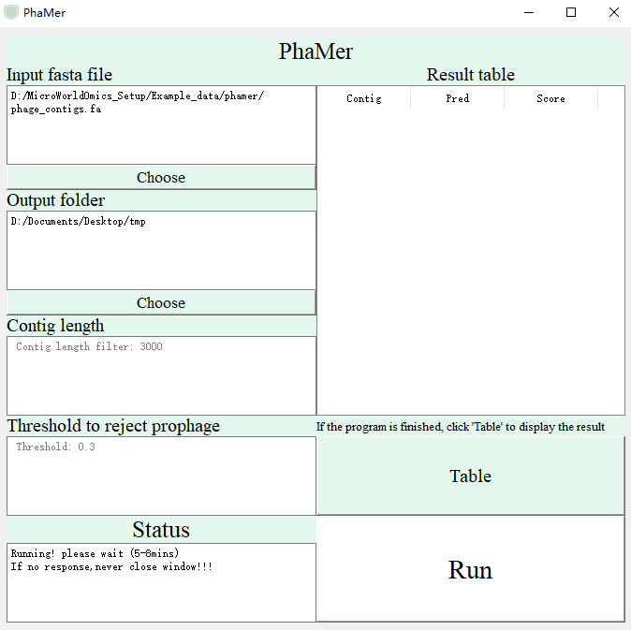
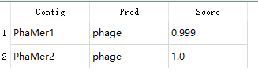
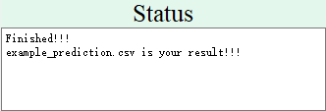
PhaMer - Identify the phage sequence
The results are presented as follows: The first column represents the name of the contigs, the second column shows the discriminant category, and if it is a phage sequence, it is displayed as "phage", and the third column shows the discriminant score. A score close to "1" indicates a higher possibility that it is a phage sequence
Input phage/bacterial and fungal genomes (contigs)
The target folder of the output file (user-defined)
The minimum contig length of the filter (contigs shorter than this length are not included in the calculation)
The table results are in the result folder "example_prediction.csv"
Reject prophage threshold (Default 0.3)
Click this button to display the table
The status bar is completed
The status bar is running

Slide 16
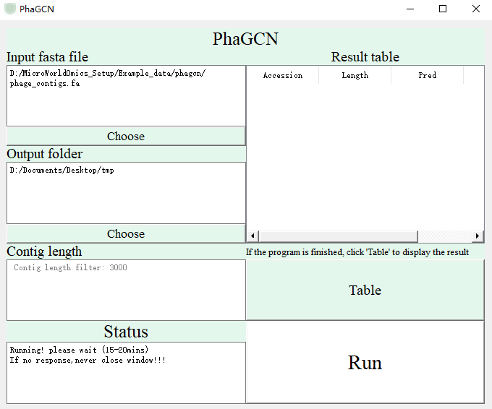
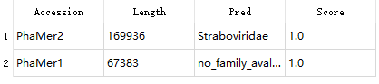
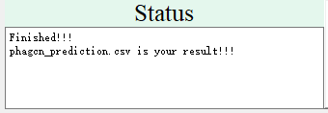
PhaGCN - Species identification
The results are shown as follows: The first column is the name of the contigs, the second column is the length of the contig, the third column is the species identification category (Famliy level), and the fourth column is the discriminant score. A score close to "1" indicates a higher possibility that it belongs to this category
Input phage genomes (contigs)
The target folder of the output file (user-defined)
The table results are in the result folder "phagcn_prediction.csv"
The minimum contig length of the filter (contigs shorter than this length are not included in the calculation)
Click this button to display the table
The status bar is completed
The status bar is running

Slide 17
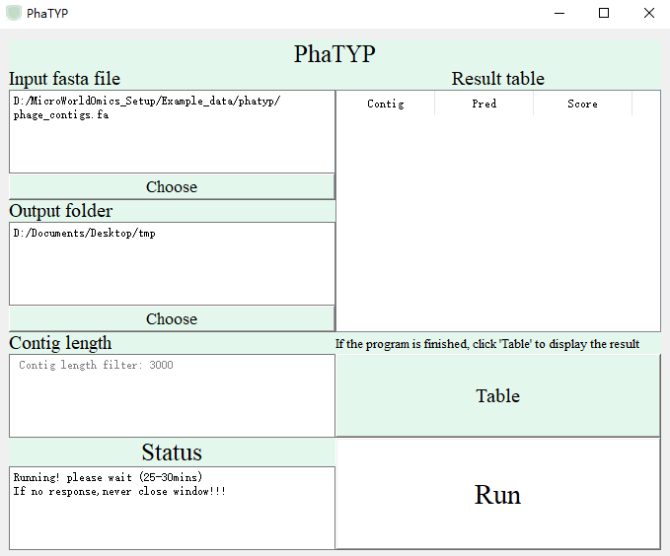
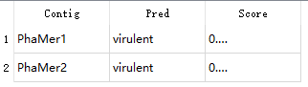
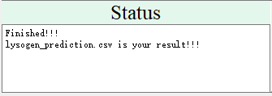
PhaTYP – Life style identification
The results are shown as follows: The first column is the name of the contigs, the second column is the discriminant category, and if it is a virulent bacteriophage, it is displayed as "virulent"; otherwise, it is "Lysogen", and the third column is the discriminant score. A score close to "1" indicates a higher possibility that it is "Lysogen", and a score close to "0" indicates a higher possibility that it is "virulent"
Input phage genomes (contigs)
The target folder of the output file (user-defined)
The table results are in the result folder "lysogen_prediction.csv"
The minimum contig length of the filter (contigs shorter than this length are not included in the calculation)
Click this button to display the table
The status bar is completed
The status bar is running

Slide 18
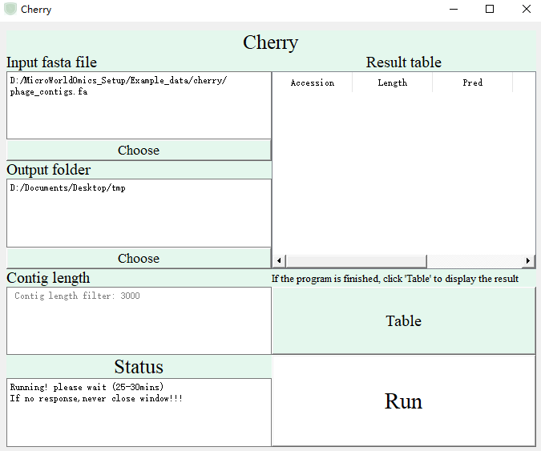
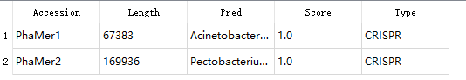
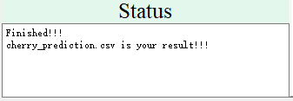
Cherry – Host prediction
The results are as follows: The first column is the contigs name, the second column is the contigs length, the third column is the host identification category (family level), and the fourth column is the discriminant score. A score close to "1" indicates a higher possibility that it belongs to this category. The fifth column shows the discrimination method, where "CRISPR" represents the use of crispr for host matching
Input phage genomes (contigs)
The target folder of the output file (user-defined)
The table results are in the result folder “cherry_prediction.csv"
The minimum contig length of the filter (contigs shorter than this length are not included in the calculation)
Click this button to display the table
The status bar is completed
The status bar is running

Slide 19
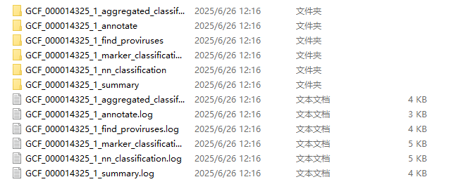
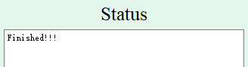
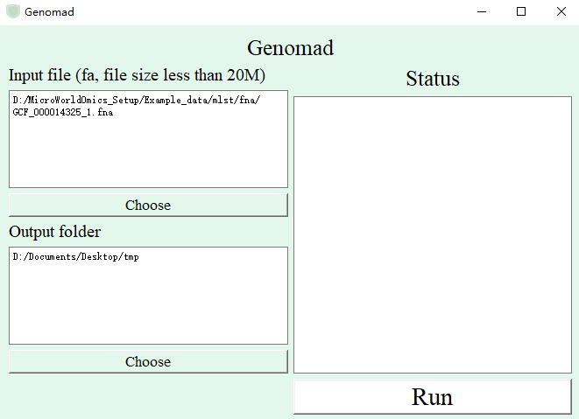
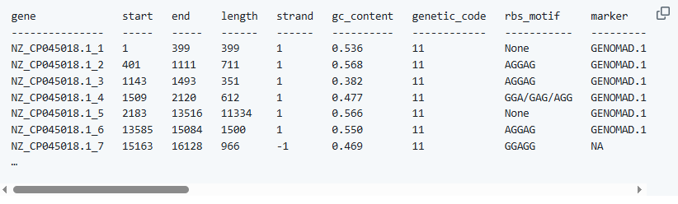
Genomad – Mobile elements identification
The status bar is completed
Input bacterial genomes (contigs)
The target folder of the output file (user-defined)
Interpretation results can be reference: https://github.com/apcamargo/genomad/

Slide 20
Epidemiological analysis
MLST - Multi-Locus Sequence Typing
Serotype - Serotype analysis
Gene identification – Drug resistance genes
Core genome construction
Molecular clock analysis
Prokka annotation
Bayesian clustering

Slide 21
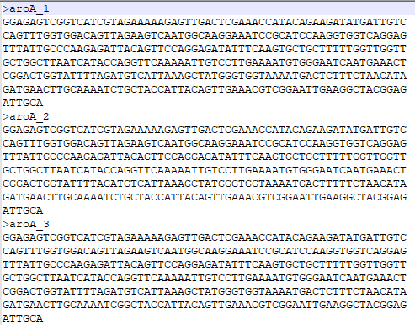
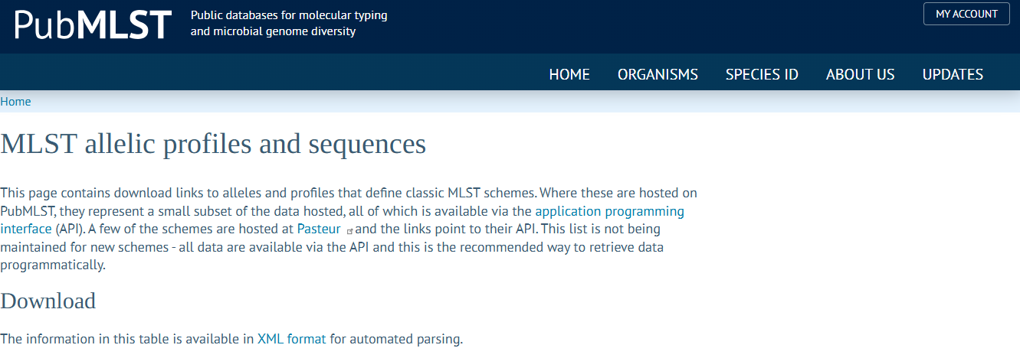
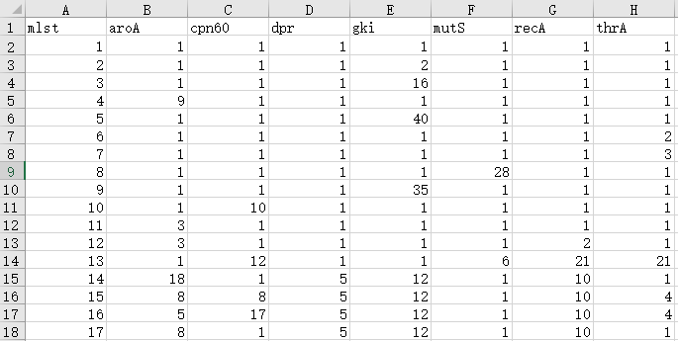

MLST - Multi-Locus Sequence Typing
The housekeeping gene sequence was copied into the same fa file in order (official website order)
https://pubmlst.org/data
Housekeeping genes
Existing ST library
Input folder: Put all fa files into the same folder
ST type and housekeeping gene information (official website order) are retained, and redundant columns are deleted

Slide 22



MLST - Multi-Locus Sequence Typing
Input bacterial genomes folder (contigs)
The first column represents the number of the strain, the second column represents the ST type, and the third column represents the combination of the number of housekeeping genes detected
The target folder of the output file (user-defined)
Housekeeping genes associated with bacteria
Existing ST library
Click this button to display the table
The status bar is completed
The status bar is running

Slide 23


Serotype - Serotype analysis
Input bacterial genomes folder (contigs)
The target folder of the output file (user-defined)
Serotype gene, collected from the literature
Designed for the differentiation of Streptococcus suis serotypes 1 and 14, as well as types 2 and 1/2
The first column represents the strain number, and the second column represents the serotype
The precise mode is targeted at Streptococcus suis serotypes 1 and 14, as well as types 2 and 1/2
Click this button to display the table
Status bar

Slide 24


Gene identification – Drug resistance genes
Input bacterial genomes folder (contigs)
The target folder of the output file (user-defined)
Target gene fa (Drug resistance genes, If there are multiple genes, they should be placed in the same fa file)
The first column represents the strain number, and the second column represents the identified gene
The identity threshold with the target gene
If the overlapping part of two genes at the same position that meet the condition is greater than this threshold, take the one with the greatest identity
The coverage threshold with the target gene
Nucleic acid identification and protein identification
Click this button to display the table
Status bar

Slide 25


Core genome construction
The identity threshold to identify core genes
The coverage threshold to identify core genes
Input bacterial genomes folder (contigs)
The target folder of the output file (user-defined)
The reference strains of this category of bacteria need to be first annotated in ffn format using prokka
The status bar is running
The status bar is completed

Slide 26



Core genome construction
Result
https://www.ncbi.nlm.nih.gov/datasets/taxonomy/1307/
All_core_genes_aln.fasta: please ignore the intermediate files of the software operation
All_isolates_core_genes.fna: the fa file of the core gene
core_gene_list.out : the entry of the core gene,'::' is followed by the length of the core gene
Core_genome.aln: The file with all core genes aligned for each isolate is used to build an evolutionary tree
Isolates_gene_number.out: The number of genes in each isolate
Take Streptococcus suis as an example. Download the genome of Streptococcus suis from the following website for reference, and then annotate it with prokka to obtain the ffn file

Slide 27








Molecular clock analysis
Begin
Finish
Click to start
Panel
Open Shiny app
Display the label "Molecular dating tree"
Input file 1: Tree file (newick)
Input file 2: date.csv
"id" represents the name of the isolate
"Rate" represents a temporal signals
Molecular dating tree

Slide 28


Prokka annotation
Input genome (contigs)
The interpretation of the results, please reference prokka:
https://github.com/tseemann/prokka
The target folder of the output file (user-defined)
The status bar is running
Result prefix
Archaea | Bacteria |
Mitochondria | Viruses

Slide 29






Bayesian clustering
Begin
Finish
Input all genome fa file
The depth of clustering, where 2 represents two-level clustering
Click to start
Open Shiny app
The maximum quantity of each clustering
Select the visual clustering level
Bayesian clustering at different levels

Slide 30
Network construction
Correlation & regression-based – REBACCA, CCLasso, WGCNA
Graphical model inference – SpiecEasi
Cosine-based network – LSA
Differential network analysis - DiffCoEx

Slide 31

Network construction

Slide 32




Network construction - Correlation & regression-based
Begin
Begin
Finish
Finish
Click to start
Click to start
Open Shiny app
Open Shiny app
OUT matrix
Start to run

Slide 33




Network construction - Correlation & regression-based
Begin
Finish
Click to start
Open Shiny app

Slide 34





Network construction - Correlation & regression-based

Slide 35



Network construction - Correlation & regression-based

Slide 36





Network construction - Graphical model inference
Begin
Finish
Click to start
Open Shiny app
MB
Sparcc

Slide 37



Network construction - Cosine-based network
Begin
Finish
Click to start
Open Shiny app

Slide 38





Network construction - Differential network
Begin
Finish
Click to start
Open Shiny app

Slide 39
Microbiome analysis
Comprehensive analysis of the microbiome
Difference analysis – NetMoss, Maaslin2
Batch effect analysis

Slide 40







Microbiome analysis - Microbial diversity
Begin
Finish
Click to start
Open Shiny app

Slide 41







Microbiome analysis - Cluster analysis

Slide 42





Microbiome analysis - Relative abundance analysis

Slide 43







Microbiome analysis - Relative abundance analysis
Begin
Finish
Fix effect
Random effect
Click to start
Open Shiny app

Slide 44





Microbiome analysis - Batch effect analysis
Begin
Finish
Click to start
Open Shiny app

Slide 45
Basic graphic drawing
Chemical structure drawing
Protein structure drawing

Slide 46


Chemical structure drawing

Slide 47


Protein structure drawing
Shiny3Dprotein
ShinyTMscoreAlign

Slide 48
Basic function
Blast
Alignment
Build tree
Activity

Slide 49



BlastN
Reference sequence (fasta)
Running
Finished
Query sequence (fasta)
BLASTdb
needs to be prefixed (the prefix in the example is "target")
E value
BLASTdb
Output format
Output file

Slide 50
BlastP
Reference sequence (fasta)
Running
Finished
Query sequence (fasta)
BLASTdb
needs to be prefixed (the prefix in the example is "target")
E value
BLASTdb
Output format
Output file

Slide 51

BlastX
Reference sequence (fasta)
Running
Finished
Query sequence (fasta)
BLASTdb
needs to be prefixed (the prefix in the example is "target")
E value
BLASTdb
Output format
Output file

Slide 52

tBlastN
Reference sequence (fasta)
Running
Finished
Query sequence (fasta)
BLASTdb
needs to be prefixed (the prefix in the example is "target")
E value
BLASTdb
Output format
Output file

Slide 53

tBlastX
Reference sequence (fasta)
Running
Finished
Query sequence (fasta)
BLASTdb
needs to be prefixed (the prefix in the example is "target")
E value
BLASTdb
Output format
Output file

Slide 54

Alignment - Clustal for example
Put all sequences that need to be aligned into the same fasta file
Output file (.aln)

Slide 55

Build Tree - Fasttree for example
Output tree file (.nwk)
Put all sequences that need to be aligned into the same fasta file
Different construction models, divided into nucleic acids and proteins:
GTR: General Time Reversible Model
LG: Le and Gascuel
WAG: Whelan & Goldman

Slide 56

Peptides activity
Protein sequence (fa)
The result table shows that the first column is the protein ID, the second column is the sequence, and the third column is the activity score (0-1). A score close to 1 indicates better activity
Output table

Slide 57

Lysins activity
Protein sequence (fa, without AA: "B","Z","J","O","U","X",'*')
The result table shows that the first column is the protein ID, the second column is the sequence, and the third column is the activity score (0-1). A score close to 1 indicates better activity
Output table

